Slide 1
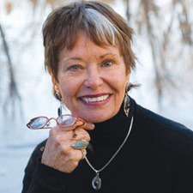
Nursing theory:
An Exploration of Jean Watson’s Philosophy & Science of Caring
Ferris State University, NURS 324
Amy Johns
Brandi Miller
Patricia Moon
Photo: (Institute of Noetic Sciences, 2013)

Slide 2
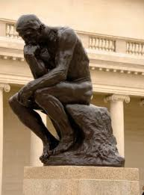
What Is Nursing Theory?
An organized, systematic group of concepts, definitions, and statements that describe nursing phenomena and can be used to predict or explain outcomes
(Black, 2011)
(Current Nursing, 2012)
Photo: (Fellowship of the Minds, n.d.)

Slide 3
Why Is Nursing Theory Important?
Develops and clarifies the body of nursing knowledge
Enhances the status of nursing as both an academic discipline and a profession
Improves the quality of patient care
Enhances reasoning, critical thinking, and decision making in nursing practice
(Tomey & Alligood, 2006)

Slide 4
Theory Components
Theory Components | Contributions to the Theory
CONCEPTS & DEFINITIONS
Concepts | Describe and classify phenomena of interest
Theoretical definitions of concepts | Establish clear meaning
Operational definitions of concepts | Provide for empirical measurement
RELATIONAL STATEMENTS
Theoretical statements | Relate concepts to one another; permit analysis
Operational statements | Relate concepts to measurements
LINKAGES & ORDERING
Linkages of theoretical statements | Provide rationale of why theoretical statements are linked; add plausibility
Linkages of operational statements | Provide rationale for how measurement variables are linked; permit testability
Organization of concepts and definitions into primitive and derived terms | Eliminates overlap
Organization of statements and linkages into premises and derived hypotheses and equations | Eliminates inconsistency
(Tomey & Alligood, 2006, p. 36)

Slide 5

Types of Nursing Theoretical Works
Philosophies
Conceptual Models
Theories
Middle Range Nursing Theories

Slide 6
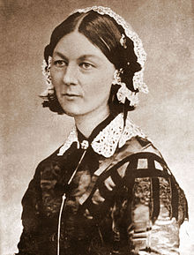
Philosophies
Clarify values and provide a broad understanding and general view of nursing
Represent early works that predate the theory era and later works of a philosophical nature
Contribute to nursing knowledge as a basis for professional scholarship leading to theory development
Examples:
  Florence Nightingale: Modern Nursing
  Jean Watson: Philosophy and Science of Caring
  Patricia Benner: From Novice to Expert
Florence Nightingale Photo: (Wikipedia, n.d.)
(Black, 2011)
(Tomey & Alligood, 2006)

Slide 7
Conceptual Models
Broad, conceptual structures that describe the nature of nursing concepts and address the broad metaparadigm
Include concepts, definitions, and propositions, and their interrelationships to form an organized perspective for viewing nursing phenomena
Less abstract and more formalized than philosophies
More abstract than theories; used to build theories
Examples:
  Martha E. Rogers: Unitary Human Beings
  Dorothea E. Orem: Self-Care Deficit Theory of Nursing
  Imogene King: Interacting Systems Framework and Theory of Goal Attainment
(Black, 2011)
(Tomey & Alligood, 2006)

Slide 8
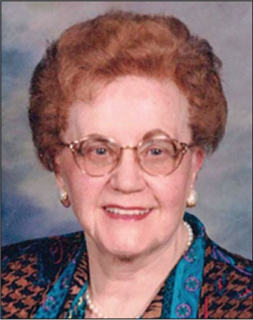
Theories
Grand nursing theories are abstract conceptual structures that are derived from nursing models and propose outcomes based on use and application of the model
Theories describe, explain, control or predict nursing phenomena
Both grand nursing theories and theories provide focus for development of middle range theories
Examples:
  Madeleine Leininger: Culture Care Theory of Diversity and Universality
  Ida Jean Orlando (Pelletier): Nursing Process Theory
  Nola J. Pender: Health Promotion Model
Madeleine
Leininger
Photo: (Healio, 2013)
(Black, 2011)
(Tomey & Alligood, 2006)

Slide 9
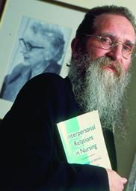
Middle Range Nursing Theories
Describe nursing phenomena, explain relationships between phenomena, and predict the effects of one phenomena on another within a limited dimension of nursing practice
Propose specific outcomes with a narrow nursing focus
Make connections between grand theories and nursing practice
Examples:
  Ramona T. Mercer: Maternal Role Attainment – Becoming a Mother
  Carolyn L. Wiener and Marylin J. Dodd: Theory of Illness Trajectory
  Phil Barker: Tidal Model of Mental Health Recovery
Phil
Barker
Photo: (Nursing Times.net, 2013)
(Black, 2011)
(Tomey & Alligood, 2006)

Slide 10
Jean Watson's
Philosophy & Science of Caring
Nursing is a human science based on values and concerned with health promotion, health restoration, and illness prevention
Caring is central to nursing and is an intentional value that manifests itself in concrete acts
Nursing practice is based on holistic carative factors; it contrasts with medicine which is based on curative factors
The nurse and patient change together as they participate in the transpersonal caring process
(Black, 2011)
(McCance, McKenna, & Boore, 1999)
(Tomey & Alligood, 2006)

Slide 11
Credentials & Background
Born and raised in the Appalachian Mountains of West Virginia
Graduated from the Lewis Gale School of Nursing
Moved to Colorado in 1961; attended University of Colorado
Master’s in Psychiatric-Mental Health Nursing; Doctorate in Educational Psychology and Counseling
Joined University of Colorado School of Nursing faculty and became Director of Nursing PhD program before traveling on sabbatical
Dean of University of Colorado School of Nursing
Distinguished Professor of Nursing; Murchinson-Scoville Endowed Chair at University of Colorado School of Nursing
(Tomey & Alligood, 2006)

Slide 12
Theoretical Sources
Nursing knowledge combined with theories from Nightingale, Henderson, Leininger, Maslow, Erickson, and Whitehead
Guidance from feminist theory, quantum physics, traditional wisdom, perennial philosophy, sciences, and humanities
States “my early work emerged from my own values, beliefs, and perceptions about personhood, life, health, and healing”(Tomey & Alligood, 2006, p. 94)
Emphasis on congruence, empathy and warmth credited to transpersonal psychology and Carl Rogers
Believes nurses need solid background in liberal arts and humanities to develop personal growth and thinking skills
(Tomey & Alligood, 2006)

Slide 13

Major Concepts & Definitions
Watson’s Ten Carative Factors
Photo: (Watson Caring Science Institute, n.d.)

Slide 14
Formation of a humanistic-altruistic system of values
Definition: Practice of loving-kindness within the context of caring consciousness.
“We can become part of a global vision of health and human transformation to help purify the toxins and poisons; the negativity of violence, abuse, war; the noncaring and disregard for the human-environment-universe connection for self and all living things.” (Watson, 2008, location 847)
Use in Nursing Practice:
“Be the work” and be a living model of caring and altruistic values
Cultivate a mindset of gratitude, loving kindness and compassion
Develop equanimity, an inner state of balance and a noninterference of what is
(Watson, 2008)

Slide 15

Instillation of faith-hope
Definition: Being authentically present and enabling and sustaining the deep belief system and subjective life-world of self and one being cared for.
“We cannot ignore the importance of hope and
faith and the role they play in people’s lives, especially
when faced with the unknowns, mysteries, and crises
of illness, pain, loss, stress, despair, grief, trauma, death”
(Watson, 2008, location 1098)
Use in Nursing Practice:
In times when there is no concrete, tangible modality to be done, an expression of faith and hope from us can allow another to access this part of themselves
Attend and support the balance of mind-body-spirit and develop a holistic sense of caring
“Field of Hope” by Kirsten Bailey (2010)
(Adventist Hinsdale Hospital, 2011)
(Watson, 2008)

Slide 16
Cultivation of Sensitivity to Self & Others
Definition: Cultivation of one’s own spiritual practices and transpersonal self going beyond the ego self.
“…the source of maturity, reflection, insight and mindfulness for developing an evolved consciousness is within.” (Watson, 2008, location 1174)
Use in Nursing Practice:
Cultivate one’s own spiritual growth, insight, mindfulness in order to be sensitive to self and others
Acceptance and cultivation of these qualities fosters spiritual development and is the basis for transpersonal connections
(Watson, 2008)

Slide 17
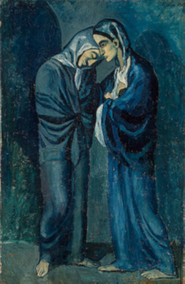
Development of Helping-Trust Relationship
Definition: Developing and sustaining a helping, trusting, authentic, caring relationship.
“It is life-giving, human-to-human, spirit-to-spirit connection…” (Watson, 2008, location 1233)
Use in Nursing Practice:
Base our practice on respect, trust, love, and person-centered relationships, and build on previous carative factors of self discovery and self knowledge
Relationship-centered care focused on layers of relationships:
  Practitioner to self
  Practitioner to patient
  Practitioner to community
  Practitioner to practitioner
“Two Sisters (The Meeting)” by Pablo Picasso (1902)
(Watson, 2008)

Slide 18
Promotion & Acceptance of the Expression of Positive & Negative Feelings
Definition: Being present to, and supporting of, the expression of positive and negative feelings as a connection with deeper spirit and self and the one-being-cared for.
“When one is able to hold the tears or fears of another without being threatened or turning away, that is an act of healing and caring.” (Watson, 2008, location 1615)
Use in Nursing Practice:
Allow a person’s feelings, honor and accept them, both positive and negative
This allowance may enable a person to move through and release negative feelings on the way to growth
This discovery of an unknown part of self will result in new dimensions of the knowledge of self and of relationships
(Watson, 2008)

Slide 19
Systematic Use of the Scientific Problem Solving Method for Decision Making
Definition: Creative use of self and all ways of knowing as part of the caring process; to engage in the artistry of caring-healing practices.
“Information is not knowledge; knowledge alone does not mean understanding; even understanding, in isolation, does not necessarily include insight, reflection, and wisdom.” (Watson, 2008, location 1735)
Use in Nursing Practice:
The nursing process is a guide for nurses’ decision making but is linear and does not allow for the complexity of the human condition
Make communication a tool on equal footing with evidence-based practices
Acknowledge that computerized documentation systems are not developed to quantify or reflect the artistry of the carative factors
(Watson, 2008)
(Watson, 2009)

Slide 20
Promotion of Interpersonal Teaching-Learning
Definition: Engaging in genuine teaching-learning experience that attends to unity of being and meaning, attempting to stay within other’s frame of reference.
“…the person becomes his or her own best problem solver; the individual is his or her own best source for finding unique creative solutions for meeting goals and a vision for change.” (Watson, 2008, location 2047)
“…the nurse becomes more of a sojourner along with the other, helping the other find new energy, time, and ways to excel by working from the inside out, connecting with his or her inner spirit…” (Watson, 2008, location 2047)
Use in Nursing Practice:
Cultivate sensitivity to the whole person; accurately detect another’s feelings, thoughts, reactions and mood to capture a teaching moment and connect with the learner
Foster in the learner the ability to determine their own needs and self-care
(Watson, 2008)

Slide 21
Provision for Supportive, Protective & Corrective Mental, Physical, Sociocultural & Spiritual Environment
Definition: Creating healing environment at all levels (physical as well as nonphysical, subtle environment of energy and consciousness, whereby wholeness, beauty, comfort, dignity and peace are potentiated).
“What we hold in our heart matters.” (Watson, 2008, location 2241)
Use in Nursing Practice:
Attend to the physical and the environmental to facilitate peace and healing
Attend to the environment beyond the most obvious to include those of energy and consciousness
Free your mind and practice all the carative factors before entering the room
(Watson, 2008)

Slide 22
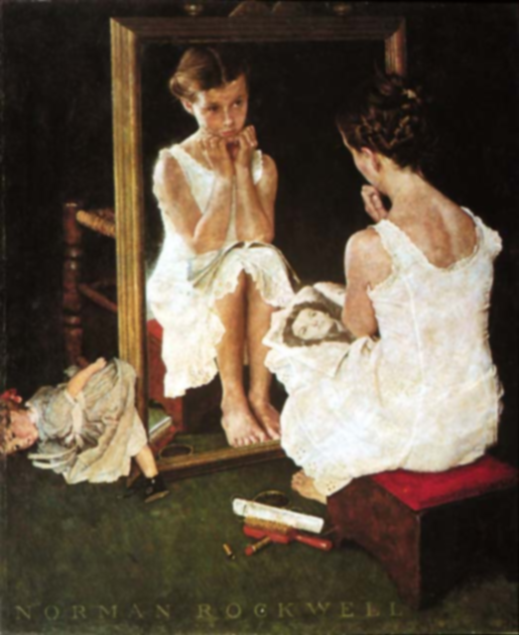
Assistance with Gratification of Human Needs
Definition: Assisting with basic needs, with an intentional caring consciousness, administering “human care essentials,” which potentiate alignment of mind-body-spirit, wholeness, and unity of being in all aspects of care.
Use in Nursing Practice:
Human care essentials or basic human needs are recognized:
  Food and Fluid
  Toileting/Bathing/Personal Appearance
  Ventilation
  Activity/Inactivity
  Sexuality/Creativity/Intimacy/Loving
  Achievement: Expressivity/Work/Contributing Beyond Self
  Need for Affiliation: Belonging/Family/Social Relations/Culture
  Need for Self-Actualization/Spiritual Growth
“Girl at Mirror” by Norman Rockwell (1954)
(Watson, 2008)

Slide 23
Allowance for Existential Phenomenological forces
Definition: Opening and attending to spiritual-mysterious and existential dimensions of one’s own life-death; soul care for self and the one-being-cared for.
“…what is happening to another in the outer world may not necessarily reflect the inner subjective unknowns or deeper dimensions of the larger universe.” (Watson, 2008, location 3061)
Use in Nursing Practice:
Be open to “allowing for a miracle” (Watson 2008, location 3061)
This lends meaning to life and death and can turn a tragedy into an opportunity for the realization of another dimension of reality
Can inspire a miracle of strength and courage
(Watson, 2008)

Slide 24
Summary of Watson’s
Ten Carative Factors
Formation of a humanistic-altruistic system of values
Instillation of faith-hope
Cultivation of sensitivity to self & others
Development of a helping-trusting relationship
Promotion & acceptance of the expression of positive & negative feelings
Systematic use of the scientific problem solving method for decision making
Promotion of interpersonal teaching-learning
Provision for supportive, protective & corrective mental, physical, sociocultural & spiritual environment
Assistance with gratification of human needs
Allowance for existential phenomenological forces
(Tomey & Alligood, 2006)

Slide 25
Use of Empirical Evidence
Data collection is used to classify caring behaviors and differentiate between taking care of patients and caring about patients
Difference between theory and practice is due to the use of nurses as medical consultants and administrators, thus decreasing their ability to be caring
Watson and colleagues used an open-ended questionnaire with patients and nurses
  Questions about individual values and the need to meet minimum care needs before determining quality of care
  Found discrepancies between what patients and nurses feel is important
(Ranheim, Karner, & Bertero, 2012)
(Tomey & Alligood, 2006)

Slide 26
Seven Major Assumptions
Caring can only be effectively demonstrated and practiced interpersonally
Caring consists of carative factors that result in the satisfaction of certain human needs
Effective caring promotes health and individual or family growth
Caring responses accept a person not only as he or she is now but as what he or she may become
Caring environment offers development of potential while allowing the person to choose the best action for himself or herself at a given time
Caring is more “healthogenic” than is curing. The practice of caring integrates biophysical knowledge with knowledge of human behavior to generate or promote health and to provide ministrations to those who are ill. A science of caring is therefore complementary to the science of curing.
The practice of caring is central to nursing
(Tomey & Alligood, 2006, p. 97)

Slide 27

Growth of Major Assumptions
Following publication of her 1979 work, Watson’s caring theory evolved from basic thinking to one of greater awareness of divine and holistic interpersonal relationships
In 1985, she proposed eleven assumptions to explain the relationship between nursing, human values, and caring for others
In 1999, Postmodern Nursing and Beyond, Watson describes an ontological shift in human consciousness by suggesting practice paths for practitioners
(Tomey & Alligood, 2006)

Slide 28
Theoretical Assertions
Health is “unity and harmony within the mind, body, and soul” (Tomey & Alligood, 2006, p.99)
Caring includes factors that allow nurses to help patients achieve health
Caring involves perception of feelings and appreciation of uniqueness of others
Theory components include human freedom, holism, a context of inter-human characteristics and an open scientific world view
The interpersonal-spiritual nature of Watson’s theory maintains the human integration with self, others, nature, and the universe
(Tomey & Alligood, 2006)

Slide 29
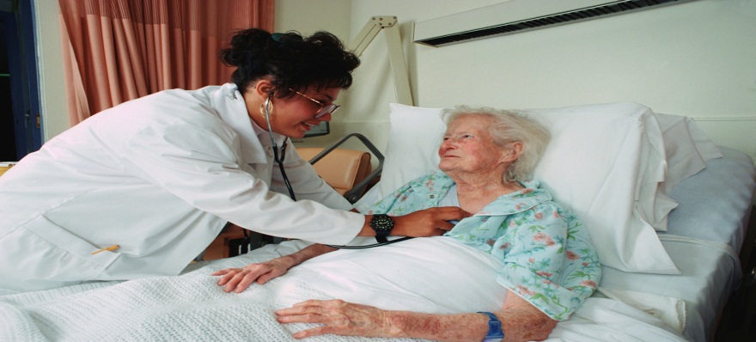
Logical Form
Separates the practice of nurses caring from the practice of medicine curing. Emphasis is on existential, phenomenological and spiritual factors.
Proponent of nursing education’s need for holistic knowledge gained through liberal education
Postmodern theory approach reflects the need for harmony, interpretation and self-trancendence
Watson seeks “greater emphasis on transpersonal caring, intentionality, caring consciousness and the caring field” (Tomey & Alligood, p. 100)
(Tomey & Alligood, 2006)

Slide 30

Use of Watson’s Philosophy in the Nursing Community
Practice
Education
Research
Photo: (Watson Caring Science Institute, n.d.)

Slide 31

Philosophy & Science of Caring in Practice
Used to counteract barriers such as short hospital stays, increased acuity, and the impersonal factor of technology
Relationship-based care developed from Watson’s theory and provides nurses with the ability to model caring in their day-to-day nursing practice
Urges all nurses to sign a proclamation dedicated to “creating world peace with caring, love and compassion” (Watson Caring Science Institute, n.d.)
Photo: (Watson Caring Science Institute, n.d.)
(Tomey & Alligood, 2006)
( Watson Caring Science Institute, n.d.)

Slide 32

Philosophy & Science of Caring in Education
Included in BSN curricula at numerous colleges and universities
Framework includes inner personal reflection, encouragement of personal growth, communication skills, attention to both nurse and patient, and increasing health and healing through the human caring process
Focuses on a “core” of nurse-patient relationships that have therapeutic outcomes versus the “trim” of procedures, tasks, and techniques
(Tomey & Alligood, 2006)

Slide 33
Philosophy & Science of Caring in Research
Studies are limited due to difficulty using concrete measures to research abstract concepts
Ranheim, Karner, & Bertero (2012) validated caring theory and showed that the difference between theory and practice is due to the use of nurses as medical consultants and administrators
There is a need for development of “esthetic, metaphysical, empirical, and contextual methods” of research (Tomey & Alligood, 2006, p. 102)
Time limitations and the subjective nature of interpersonal nurse-patient relationships decrease the possibility of acquiring data
Integration of caring theory into nursing requires research that focuses on both subjective and objective outcomes to further Watson’s work
(Ranheim, Karner, & Berteo, 2012)
(Tomey & Alligood, 2006)

Slide 34
Critique of Watson’s Philosophy
Clarity
  Use of sophisticated language and lengthy phrases often require multiple readings to gain meaning
  Poetic use of words, metaphor, and artwork give Watson’s work esthetic appeal
Simplicity
  Draws on many disciplines, requiring readers to be familiar with broad subject matter
Generality
  Provides a moral and philosophical basis for all specialties of nursing
  Focuses more on psychosocial aspects of nursing than on physiological aspects
Empirical Precision
  Strengthened by using accepted work from other disciplines
  Is not amenable to traditional scientific research methodologies; better suited to qualitative, naturalistic, or phenomenological methodologies
Derivable Consequences
  Philosophical concepts such as use of self, patient identified needs, the caring process, and spirituality guide nurses and patients to find meaning in complex health issues
(McCance, McKenna, & Boore, 1999)
(Tomey & Alligood, 2006)

Slide 35




Putting it Together: Watson’s Philosophy & Nursing’s Metaparadigm
Human Being
Valuable, and worthy of care, respect, nurturance, understanding and assistance
Greater than, and different from, the sum of one’s parts
Health
High level of adaptive physical, mental, and social functioning
Importance of health promotion and illness prevention
Environment
Nurse and patient come together in transpersonal caring-healing moments
Caring is connected with the high-energy of the universe
Nursing
“A human science of persons and human health-illness experiences that are mediated by professional, personal, scientific, aesthetic, and ethical human care transactions”
(Watson, 1985, p. 32)
(Black, 2011)
(Current Nursing, 2012)
(Lukose, 2011)
(McCance, McKenna, & Boore, 1999)

Slide 36
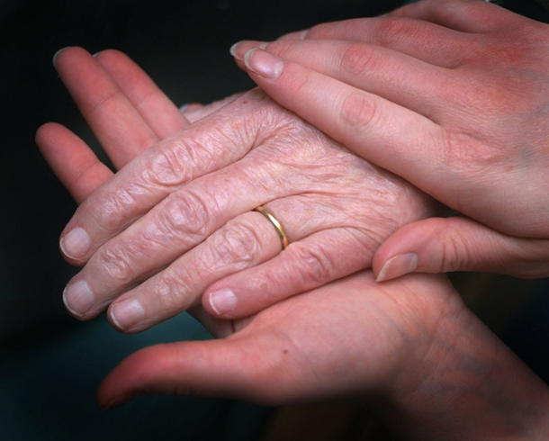
Case Study
Watson’s Philosophy & Science of Caring
Photo: (Cabanes, 2011)

Slide 37
Mary’s Story
Mary is an 81 year old, cognitively sharp, physically active woman who moved to a senior living center with her husband. There, she thrived socially and enjoyed many of the activities. Her husband does not participate and would prefer that Mary stay in the room with him. They continued to live at the assisted living center, although they became more frail. Her family keeps in touch with her, but her main “family” is now the staff that cares for her. She is able to participate in activities to some degree, interacts with the staff and other members, and is aware that she is becoming weaker and more vulnerable. Recently, she fell and broke her hip. After surgery, she was placed on a medical ward where many individuals come and go. The days are busy for staff, but for Mary, there is much confusion. She misses her husband and wonders when she will be able to be with him again. The night shift nurse reported that she found Mary crying late in the evening. When asked if she was in pain, Mary denied it.
(Weydt, 2010)

Slide 38
Using Watson’s Philosophy of Caring
Should Mary and be allowed to make the decision to return to the assisted living center?
Mary is thriving socially at the assisted living center, but her husband is not. Should they only be allowed to participate in activities as a couple?
What could be done to help Mary cope after surgery?
Mary has expressed feelings about not having anything left to live for. How can the nurse help her deal with feelings of depression?
( Weydt, 2010 )

Slide 39
References
Adventist Hinsdale Hospital. (2011). Dr. Watson’s caring theory. Retrieved from https://www.keepingyouwell.com/ahh/about-us/nursing-magnet-journey/dr-watsons-caring-theory
Black, B. P. (2011). Nursing theory: The basis for professional nursing. In K. K. Chitty & B. P. Black (Eds.), Professional nursing: Concepts and challenges (6th ed., pp. 303-323). Maryland Heights, MO: Saunders Elsevier.
Current Nursing. (2012). Nursing theories. Retrieved from http://currentnursing.com/nursing_theory/
Lukose, A. (2011). Developing a practice model for Watson’s theory of caring. Nursing Science Quarterly, 24, 27-30. doi:10.1177/0894318410389073
McCance, T. V., McKenna, H. P., & Boore, J. R. (1999). Caring: theoretical perspectives of relevance to nursing. Journal of Advanced Nursing, 30, 1388-1395.
Ranheim, A., Karner, A., & Bertero, C. (2012). Caring theory and practice – Entering a simultaneous concept analysis. Nursing Forum, 47, 78-90. doi: 10:1111/j.1744-6198.2012.00263.x
Tomey, A. M., & Alligood, M. R. (2006). Nursing theorists and their work (6th ed.). St. Louis, MO: Mosby Elsevier.
Watson Caring Science Institute. (n.d.). The caritas path to peace. Retrieved from http://watsoncaringscience.org/
Watson, J. (1985). Nursing: Human science and human care – A theory of nursing. New York: National League of Nursing Press.
Watson, J. (2008). Nursing: The philosophy and science of caring (Revised ed.) [Kindle version]. Retrieved from http://www.amazon.com
Watson, J. (2009). Assessing and measuring caring in nursing and health sciences [Kindle version]. Retrieved from http://www.amazon.com
Weydt, A., (2010). Mary’s story, relationship-based care delivery. Nursing Administration, 34, 141-146. doi: 10.1097/NAQ.0b013e3181d91751

Slide 40
Photo References
Bailey, K. (2010). Field of hope. Retrieved from http://www.klbaileyart.com/2010/06/30/field-of-hope/
Cabanes, R. V. (2011). [Photo of helping hands]. Retrieved from http://upoun207grouph.blogspot.com/2011/07/daily-diary-of-carative-factors.html
Fellowship of the Minds. (n.d.). [Photo of The Thinker]. Retrieved from http://fellowshipofminds.wordpress.com/2010/05/31/obama-the-thinker/
Healio. (2013). [Photo of Madeleine Leininger]. Retrieved from http://www.healio.com/psychiatry/journals/jpn/%7Be5037841-a93a-4616-9b2a-7b7d323ecd5a%7D/news
Institute of Noetic Sciences. (2013). [Photo of Jean Watson]. Retrieved from http://noetic.org/conference/presenters/jean-watson/
Nursing Times.net. (2013). [Photo of Phil Barker]. Retrieved from http://www.nursingtimes.net/whats-new-in-nursing/hall-of-fame/
[Photo of Florence Nightengale]. (n.d.). In Wikipedia. Retrieved from http://en.wikipedia.org/wiki/Florence_Nightingale
Picaso, P. (1902). Two sisters (The meeting). Retrieved from http://www.arthermitage.org/Pablo-Picasso/Two-Sisters.html
Rockwell, N. (1954). Girl at mirror. Retrieved from http://3.bp.blogspot.com/_yuvL3WThaI0/TFi915Kl9VI/AAAAAAAADss/T9hAveiGyoE/s640/rockwell_girlatmirror_640.jpg
Watson Caring Science Institute. (n.d.). [Seal of the lotus flower: compassion wisdom love caring]. Retrieved from http://watsoncaringscience.org/jean-live/publications/
Watson Caring Science Institute (n.d.). [Photo of pink lotus flower]. Retrieved from http://watsoncaringscience.org/

